Slide 1


Epigenetics and Chromosomal Features Drive Transposon Insertion in Drosophila Melanogaster
Tianxiong Yu, Weng Lab
Dec 2022, Epigenetics Club
Notes:
Before I start, I want to thank the fantastic club organizers, who gives us a great chance to talk about science.
So, I am Tianxiong, a postdoc in Zhiping Weng’s lab at Sherman center 5th floor. I want share you with our recent research about what drives the transposon insertion in fruit flies.

Slide 2
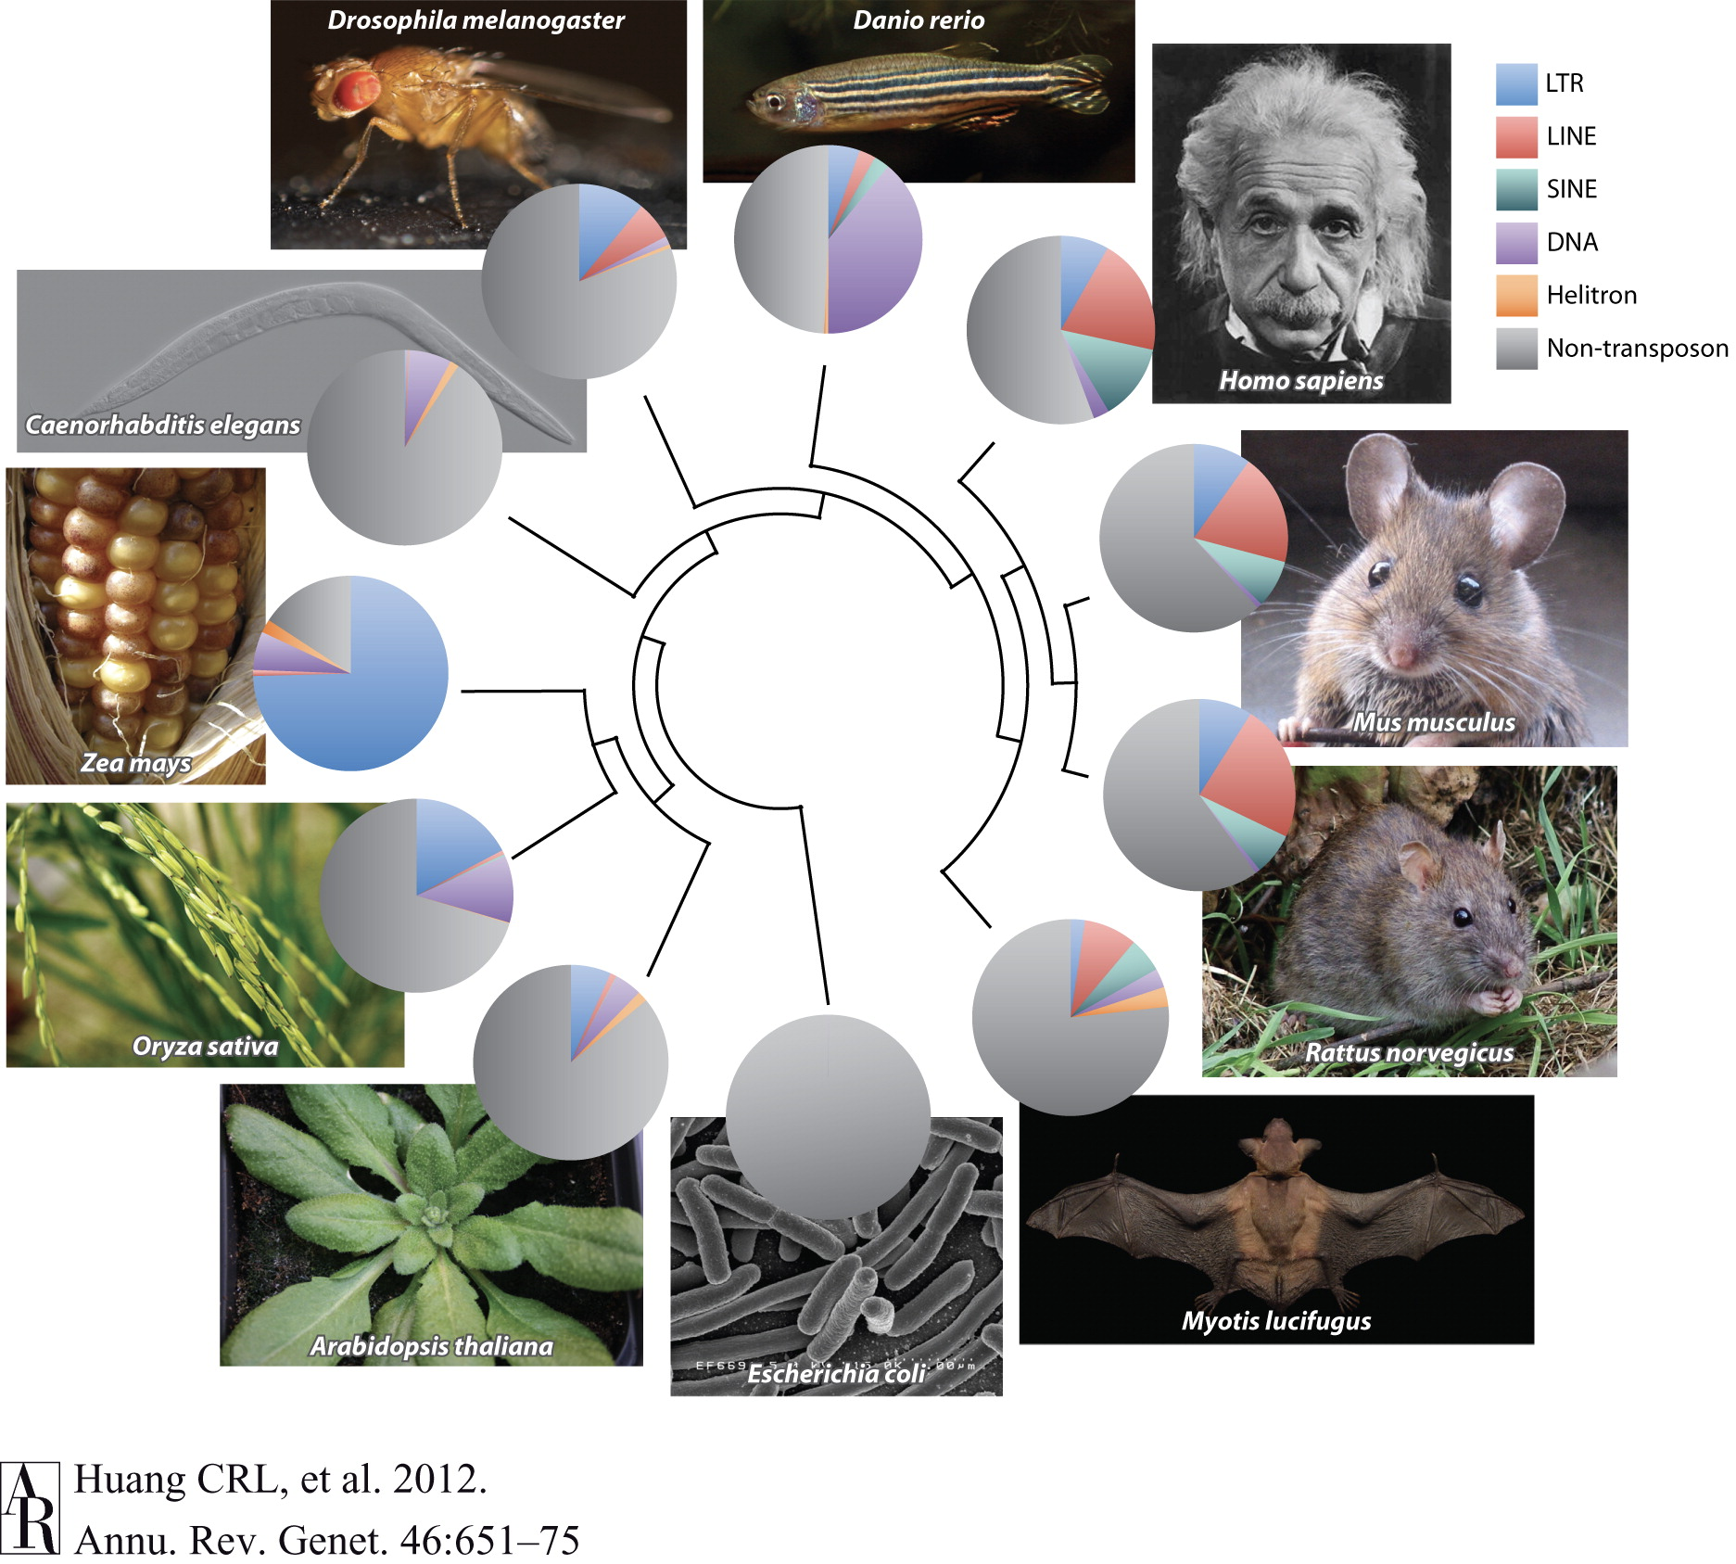

What is transposon?
Background
Image: CSHL Library & Archives
Tianxiong Yu, Weng Lab
Dec 2022, Epigenetics Club
Notes:
So, before the talk, I want to give a brief introduction about transposon.
Transposons are genes that move from one location to another on a chromosome. They are first discovered in Maize by Barbara McClintock, and she won a Nobel Prize in 1983.
A very famous example of transposon movement is the multi-colored corn kernels. If a transposon moves to a position adjacent or directly in the pigment-producing gene, the cells are unable to produce purple pigment, results in white kernel or partly white kernels rather than solid purple kernels.
Transposons not only present in maize, but also in other eukaryotes, occupies from around 15% in C. elegans to around 75% in maize. In human, about half of the genome is transposon and in fly, 20% of their genome is contributed by transposons.

Slide 3
The preference of transposon insertion loci
Background
Insertion sites
Tianxiong Yu, Weng Lab
Dec 2022, Epigenetics Club
Notes:
So where do transposon locate in eukaryotic genomes? There is no answer for most transposons. However, we do know that transposons have specific appetize for picking their insertion site.
This genome browser figure shows the key point for my talk. And clearly, the insertion sites of transposons is not randomly chosen. Certain types of transposons have their unique favorite targets.

Slide 4
Where do transposons locate?
Background
1. de novo insertion/transposition
transposon
genome
2. selection
Tianxiong Yu, Weng Lab
Dec 2022, Epigenetics Club
Notes:
However, study what drives insertion is not as easy as scanning the genomic transposons.
Indeed, the profile of transposons in the reference genome is actually formed by two procedures. The first procedure is de novo insertions which we want to study.
And the second procedure, which is considered as the main procedure to shape the nowadays transposon profile, is the selection. A simple example. When a transposon insertion is lethal, then it wouldn’t be passed to the next generation.
The second procedure is well-studied. We know transposons usually don’t locate in functional elements, especially coding sequences. They also don’t like to locate in the sense strand of genes, because the structure of transposons would make the transcription stop earlier.
However, the first procedure, which infers the real transposition mechanisms is difficult to study.

Slide 5
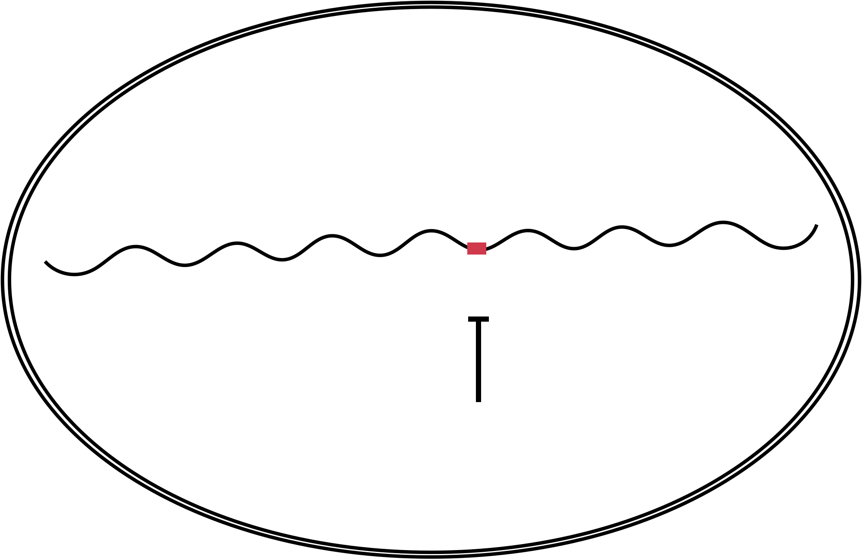

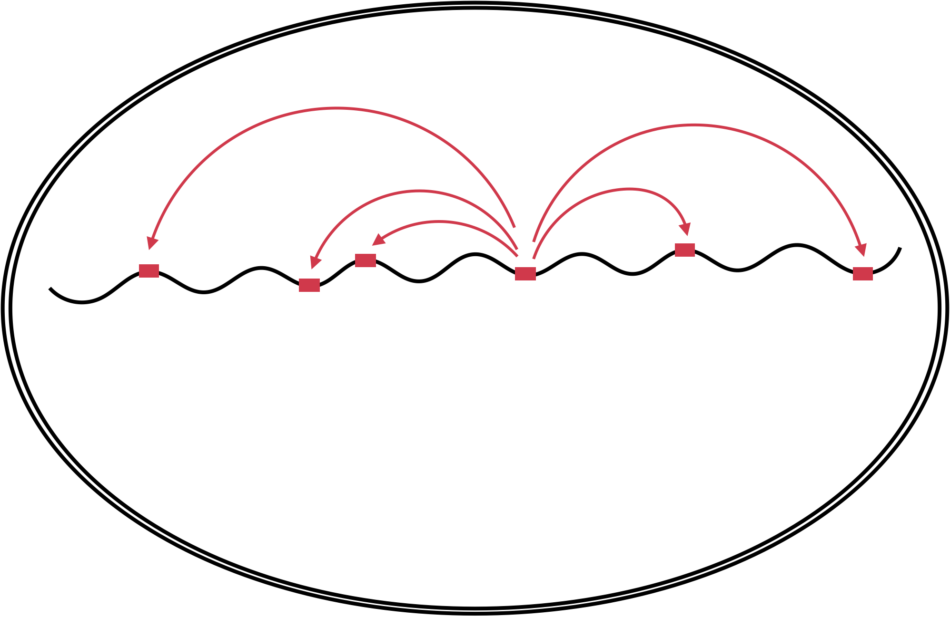
Study the de novo transposon insertions?
Background
2. Low-frequency de novo insertions are techiniquely
difficult for detection.
1. Transposons are repressed in most cells.
Germ cell
transposon
piRNA pathway
Germ cell
deplete of
piRNA pathway
Tianxiong Yu, Weng Lab
Dec 2022, Epigenetics Club
Notes:
There are two main reasons hindered the study of de novo insertion for years.
The first reason is that transposons are repressed in most cells, either by piRNA or siRNA or other mechanisms. It makes sense because organisms need to keep these genomic parasites in check to keep their genome stable.
The second reason is that it is difficult to systematically identify de novo insertions via whole genome sequencing. Generally, de novo insertion only presents in one cell, results in an extremely low frequency and makes it tricky to differentiate real insertion from sequencing artifacts such as chimeric reads from typical whole genome sequencing.
Fortunately, the two issues can be solved. In germ cells, transposons are repressed by the piRNA pathway. Upon the depletion of piRNA pathway, transposons are re-activated, and this makes it a perfect model to study de novo transposon insertions.
Also, we have developed an algorithm TEMP2. I am not going to go over the details of TEMP2, but it is able detect low-frequency de novo insertions with high accuracy.

Slide 6
Identification of transposon insertions
Results
Tianxiong Yu, Weng Lab
Dec 2022, Epigenetics Club
Notes:
So, with the model and the tools for analyzing the data, we can finally study where de novo transposons like to insert.
In 2018, ZZ’s group published two papers to study which cell types do active transposons invade. They made fly strains with activated transposons by either directly deplete the piRNA pathway or hybrid different strains to disrupt the production of transposon-silencing piRNAs. In summary, there are flies with many active LTR retrotransposons, an active LINE retrotransposon which is called I-element, and an active DNA transposon which is called P-element. ZZ’s group performed whole genome sequencing and we have utilized these dataset to for our research.
In total, we’ve identified more than 40 thousands de novo transposon insertions for four of the most active LTR transposons, I-element, and P-element.

Slide 7
Identification of transposon insertions
Results
Tianxiong Yu, Weng Lab
Dec 2022, Epigenetics Club
Notes:
So, with the model and the tools for analyzing the data, we can finally study where de novo transposons like to insert.
In 2018, ZZ’s group published two papers to study which cell types do active transposons invade. They made fly strains with activated transposons by either directly deplete the piRNA pathway or hybrid different strains to disrupt the production of transposon-silencing piRNAs. In summary, there are flies with many active LTR retrotransposons, an active LINE retrotransposon which is called I-element, and an active DNA transposon which is called P-element. ZZ’s group performed whole genome sequencing and we have utilized these dataset to for our research.
In total, we’ve identified more than 40 thousands de novo transposon insertions for four of the most active LTR transposons, I-element, and P-element.

Slide 8
Promoters and exons are potential candidates for insertion
Results
Germline insertions except P-elements are under selection.
P-element highly favors promoter for insertion.
LTR transposons prefer promoters and exons.
I-element only shows a modest enrichment at promoter.
Tianxiong Yu, Weng Lab
Dec 2022, Epigenetics Club
Notes:
So first, we want find out if transposon likes to insert into genes. We simulated random insertions, corrected for mappability, and calculated the enrichment of insertions at promoters, exons, introns, and intergenic regions. The insertions are separated by de novo marked in solid colors and germline marked in transparent colors.
Not surprisingly, except P-element, germline insertions are depleted at promoters and exons, as insertions in these regions might affect the normal transcription. This suggests high negative selection against germline insertions.
However, de novo insertions have a totally different preference. This outstanding tall green bars indicate about 5-fold enrichment at promoters for both de novo and germline P-element insertions. Indeed, P-elements are depleted in exons, introns, and intergenic regions, suggest promoters is core regions for P-element transposition.
The four LTR transposons have very similar insertion preferences across genes. Like P-element, they prefer promoters with a lower enrichment, but surprisingly, they also prefer exons as insertion sites.
De novo I-element insertion don’t show dramatic enrichment across genes like P-elements and LTR transposons, it only shows a modest enrichment at promoters.

Slide 9
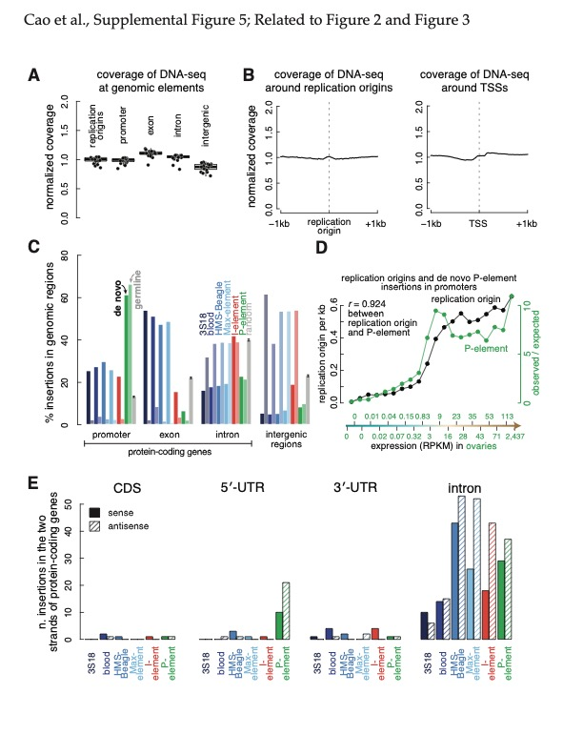
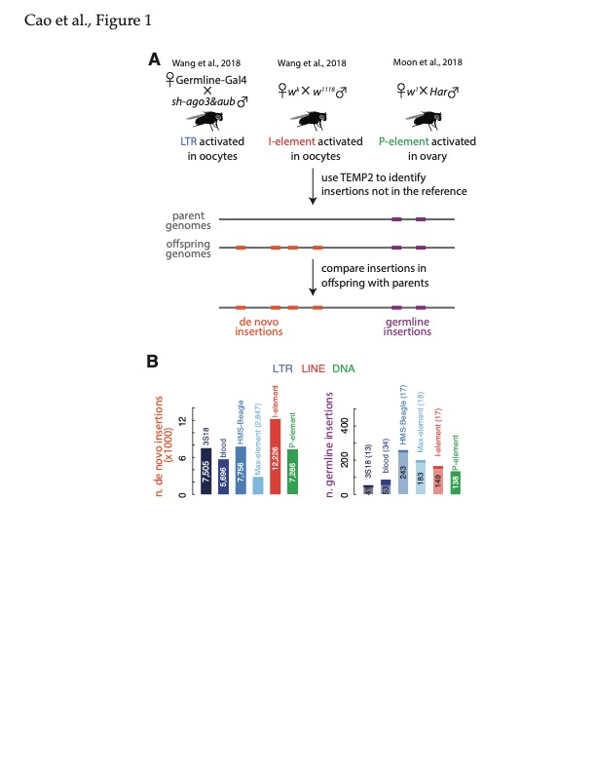
Promoters and exons are potential candidates for insertion
Results
Tianxiong Yu, Weng Lab
Dec 2022, Epigenetics Club

Slide 10
Promoters and exons are potential candidates for insertion
Results
Tianxiong Yu, Weng Lab
Dec 2022, Epigenetics Club
Notes:
The aggregation plot shows a more detailed trend of de novo insertion preference across genes.
We have separated protein-coding genes into 100 bins, ordered by their structure, from first exons to the last exons. All of the six transposons prefer promoters for integration. Specifically, it is clear that de novo LTR transposon insertions shown in blue bars are enriched in exons but not in intron, significantly separated by splice sites.

Slide 11
LTR transposons prefer to insert into active genes
Results
Tianxiong Yu, Weng Lab
Dec 2022, Epigenetics Club
Notes:
As transposons favors protein-coding genes, next we asked what is the correlation between targeting probability by insertions and the gene expression.
We divided protein-coding genes into 20 equal-sized groups based on their expression levels, each group has around eight hundreds genes. Here, each dot is the enrichment of a transposon in the promoters of a gene group. From left to right, the protein-coding genes are from most silenced to most active.
It is very consistent that blue lines keeps going up, suggesting the likelihood of de novo LTR transposition in promoters is positively correlated with the activity of genes. The conclusion stays true for the preference of de novo LTR transposon insertions in exons.
Besides LTR transposons, I-element transposition shows a less steep trend along with gene expression. And interestingly, P-element favors active promoters, but it doesn’t care how active the gene is.

Slide 12
Epigenetics features around de novo insertion sites
Results
Tianxiong Yu, Weng Lab
Dec 2022, Epigenetics Club
Notes:
So we know P-element likes promoter, and LTR transposons like both promoters and exons. We then sought to study whether the preference is driven by transcription or epigenetic features.
We download and analyze available ChIPseq and ATACseq data in fly ovaries, and assessed the enrichment of ATAC, RNA Pol II, and four well-known histone modifications around de novo insertion sites.
You might still remember that all of the six transposons favors promoters, so it is no wonder that the top four epigenetic marks enriched around promoters are also enriched around de novo insertion sites. Specifically, ATACseq, Pol II, and H3K27ac is more enriched around de novo P-element insertion sites. Also, the gene body mark H3K36me3, is specifically enriched around de novo LTR transposon insertion sites.
Indeed, more the 75% P-element targets ATAC peaks and around 60% LTR transposons target H3K36me3 peaks.

Slide 13
Open chromatin drives P-element insertion
Results
Tianxiong Yu, Weng Lab
Dec 2022, Epigenetics Club
Notes:
As P-element likes both promoters and open chromatin indicated by ATAC-seq peaks, we could help to ask which one is the determinant feature that guides the P-element insertions.
To answer this question, we separated de novo P-element insertions into four groups, according to their locations across genes. There is P-element insertions in promoters, in exons, introns, and other regions. Using Pol II ChIP-seq as a control, it is not surprise that as a promoter feature, Pol II enriches around promoter P-element insertions. It is also not surprised that Pol II doesn’t enrich around exonic, intronic, and intergenic insertions.
As we expect ATAC-seq would’ve shown the same profiles, it is not. ATAC is highly enriched around P-element insertions, no matter the insertion is located in promoters, exons, introns, or even intergenic regions. This observation indicate that, instead of promoters, open chromatin is the key feature that drives the P-element insertion.

Slide 14
H3K36me3 drives LTR transposon insertion
Results
Tianxiong Yu, Weng Lab
Dec 2022, Epigenetics Club
Notes:
Similarly, H3K36me3 enriches around LTR transposon insertions, no matter it is in exons, introns, or even intergenic regions.

Slide 15
Epigenetic features drive transposon insertions
Results
Insertion sites
Tianxiong Yu, Weng Lab
Dec 2022, Epigenetics Club
Notes:
Back to the example I showed in the beginning.
LTR transposons is either insert into promoters or exonic regions what are marked by H3K36me3. Also, we can see a lot of P-elements insert into the promoter of Vha16, and regions downstream the Vha16 TSS, which is also open chromatin regions marked by ATAC-seq.

Slide 16
I-element favors centromere distal regions
Results
Tianxiong Yu, Weng Lab
Dec 2022, Epigenetics Club
Notes:
I have introduced a lot about P-element and LTR transposons. You might ask what about I-element?
Well, I-element seems to be quite random across the fly genome, its insertions are less dependent on a specific gene structure or a specific epigenetic feature. But interesting, we found the probability of I-element insert into a site is closely correlated with its distance to centromeres.
This figure shows the number of de novo transposon insertions at each equal-sized chromosomal bins. The LTR transposon HMS-Beagle and P-element have a quite random insertion preference across different chromosomal bins, while I-element insertion preference surprisingly have a very high correlation with the distance to centromeres. I-element significantly favors those regions close to telomeres than those regions close to centromeres. We don’t know what makes this unprecedented preference, but suspect there might be something to do with CG percentage.

Slide 17
I-element favors centromere distal regions
Results
Tianxiong Yu, Weng Lab
Dec 2022, Epigenetics Club
Notes:
I have introduced a lot about P-element and LTR transposons. You might ask what about I-element?
Well, I-element seems to be quite random across the fly genome, its insertions are less dependent on a specific gene structure or a specific epigenetic feature. But interesting, we found the probability of I-element insert into a site is closely correlated with its distance to centromeres.
This figure shows the number of de novo transposon insertions at each equal-sized chromosomal bins. The LTR transposon HMS-Beagle and P-element have a quite random insertion preference across different chromosomal bins, while I-element insertion preference surprisingly have a very high correlation with the distance to centromeres. I-element significantly favors those regions close to telomeres than those regions close to centromeres. We don’t know what makes this unprecedented preference, but suspect there might be something to do with CG percentage.

Slide 18
Summary
LTR transposons are probably recruited by the transcription factors and H3K36me3 binding factors.
I-element likes to target chromosomal regions close to telomeres.
P-element insertions are driven by open chromatin related features.
Tianxiong Yu, Weng Lab
Dec 2022, Epigenetics Club
Notes:
In summary, I have talk about how three types of transposons pick their target sites in fruit flies. We found …

Slide 19

Acknowledgements
Zhiping Weng, Umass Chan
Jichuan Cao, Tongji University
William Theurkauf, Umass Chan,
…
Tianxiong Yu, Weng Lab
Dec 2022, Epigenetics Club

